Slide 1
Factorial Design and Response Surface Methodology for MEMS optimization
Published By: M. M. Saleem and A. Somá
Springer Journal 13 May 2014
Presented By: Gaurav Sitaula
7 December 2017

Slide 2
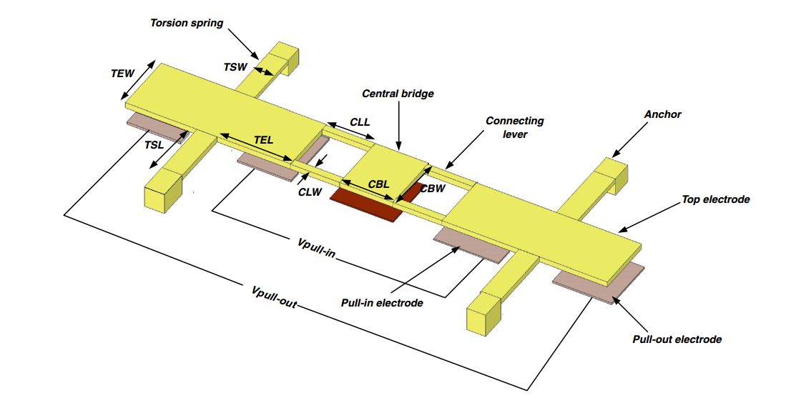
Introduction
RF MEMS(Radio Frequency MicroElectroMechanical System) have been widely used for different applications
Advantages:
low power consumption
good electrical performance
high linearity and high level of the integration as compared to other solid state devices
Disadvantages:
high actuation voltage
switching speed
low RF power handling capability
reliability
High actuation voltage leads to the charge injection which strongly affects the long term reliability of the capacitive switches
Objective: To minimize the Pull-in Voltage

Slide 3
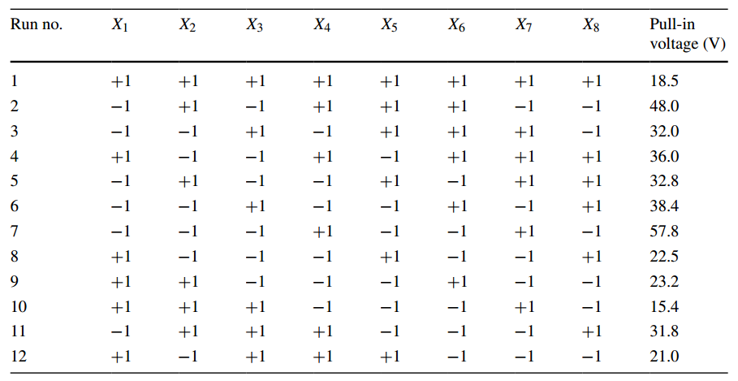
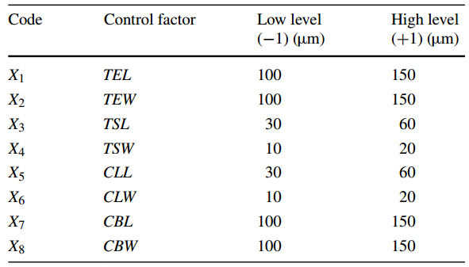
Research Design
Placket-Burman Screening Design
8 Possible Factors (each having 2 levels, +1 & -1)
Top Electrode Length (TEL)
Top Electrode Width (TEW)
Torsion Spring Length (TSL)
Torsion Spring Width (TSW)
Connecting Lever Length (CLL)
Connecting Lever Width (CLW)
Central Bridge Length (CBL)
Central Bridge Width (CBW)
12 runs (Shown in right side)
Response variable is: Pull-in Voltage (in Volts)
Response Surface Method: Box-Benken Design

Slide 4
Research Methods
STEPS:
Phase-I: Design of Experiments (P-B Factorial Design)
Estimate the Factor effects
Form initial model
Perform Statistical Testing
Refine the Model
Analyze Residuals
Interpret Results
Phase-II: Response Surface Methodology (Box-Benken Design)
Run Second Order Model (to see the Curvature)
Find the stationary point in the optimal direction

Slide 5
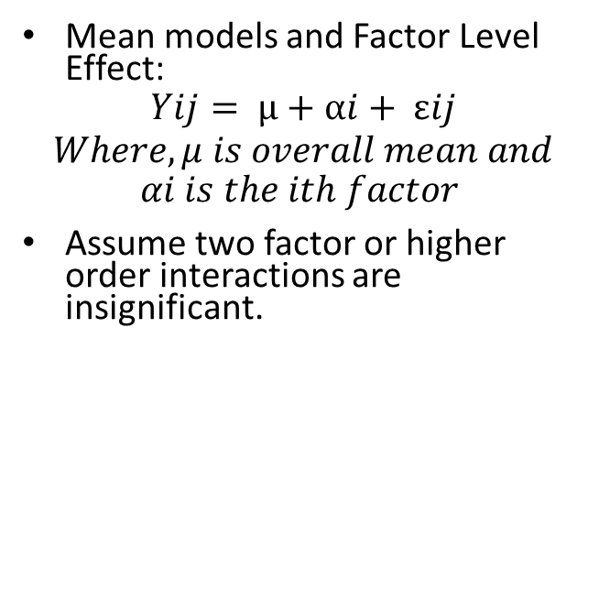
ANOVA for P-B Design
Mean models and Factor Level Effect:
$$Yij= μ+αi+ εij$$
$$Where, μ is overall mean and$$
$$αi is the ith factor$$
Assume two factor or higher order interactions are insignificant.

Slide 6
Estimate Factor Effects
The Factor estimates shows that TEL, TEW, TSL, and TSW might be significant

Slide 7
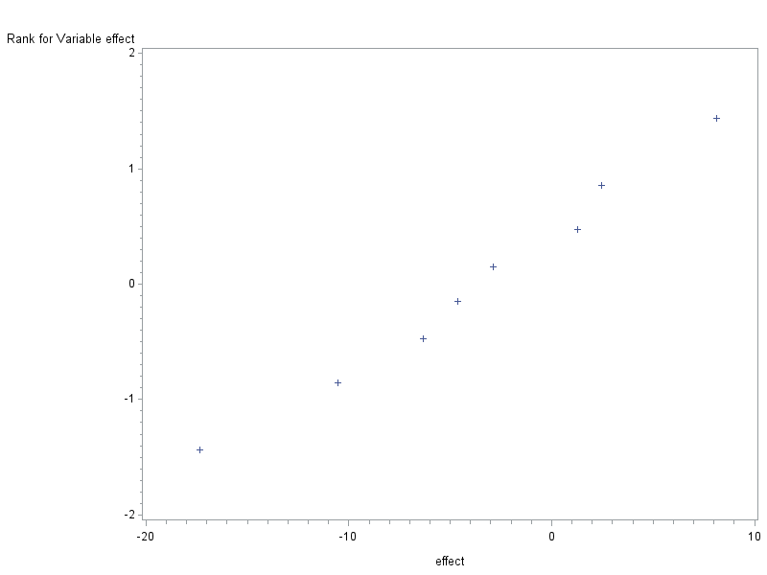
Form Initial Model i. Normal Probability Plot
A. Using SAS
B. Using Minitab

Slide 8
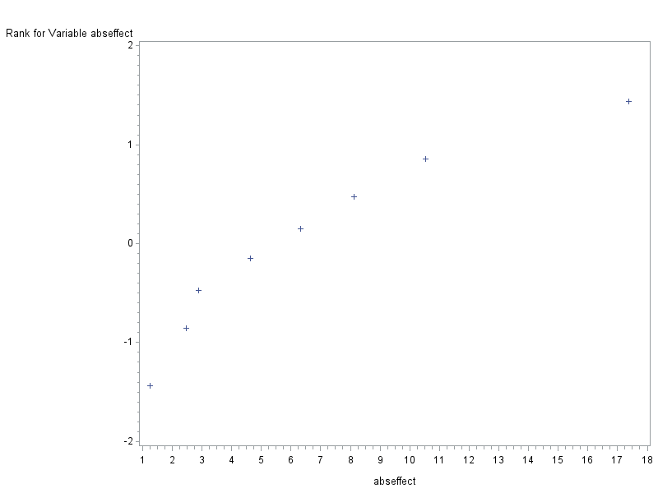
ii. Half Normal Probability Plot
A. Using SAS
B. Using Minitab

Slide 9

Form an Initial Model:
From Normal and Half Normal Probability Plot
The initial Model is:
$\text{VOLT}\text{ = }\text{μ}\text{ + }\text{TEL}\text{ + }\text{TEW}\text{+ }\text{TSL}\text{+ }\text{TSW} \text{+}\text{εij}$Plot, we have TEL, TEW, TSL, and TSW significant
Form an initial Model with
$$\text{VOLT}\text{ = }\text{μ}\text{ + }\text{TEL}\text{ + }\text{TEW}\text{+ }\text{TSL}\text{+ }\text{TSW}\text{ +}\text{εij}$$

Slide 10
Perform Statistical Testing:
m=4, α =0.05, df(SSE) = 7

Slide 11
Perform Statistical Testing:
m=4, α =0.05, df(SSE) = 7

Slide 12
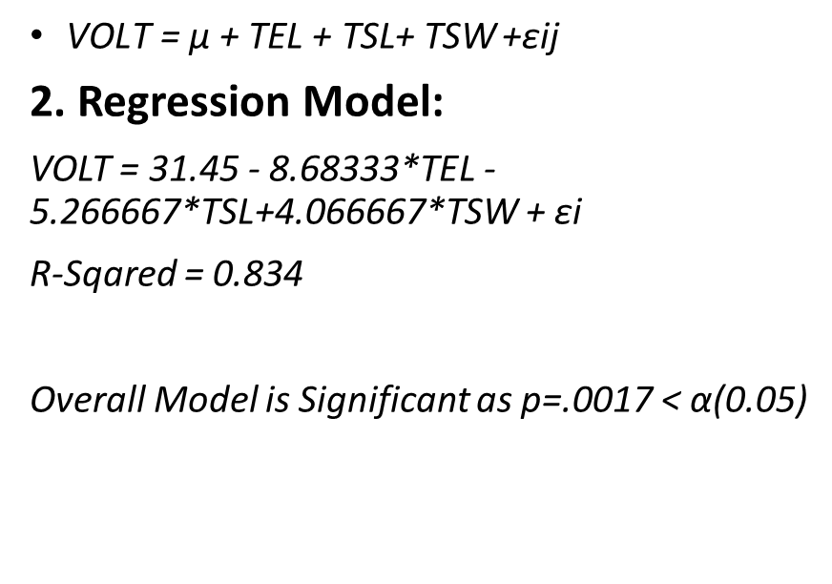
Step 4: Refine the model
1. ANOVA Model:
$\text{VOLT}\text{ = }\text{μ}\text{ + }\text{TEL}\text{ + }\text{TSL}\text{+ }\text{TSW} \text{+}\text{εij}$
2. Regression Model:
VOLT = 31.45 - 8.68333*TEL - 5.266667*TSL+4.066667*TSW + $\text{εi}$
R-Sqared = 0.834
Overall Model is Significant as p=.0017 < α(0.05)

Slide 13
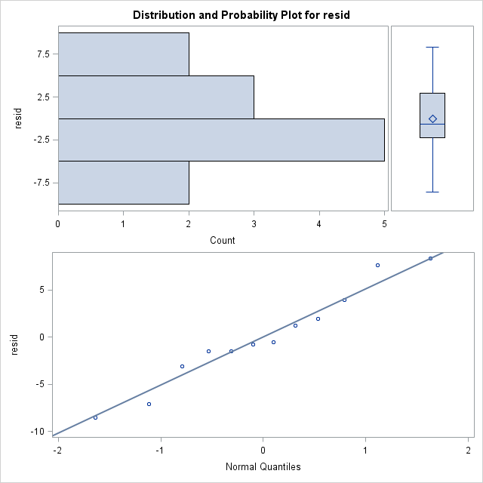
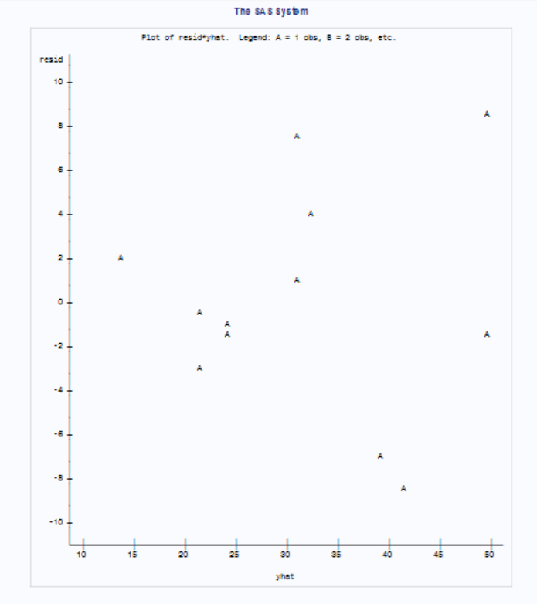
Analyze Residuals:
Normality Assumption : Fairly Satisfied
Constant Variance Assumption: Somewhat satisfied.

Slide 14
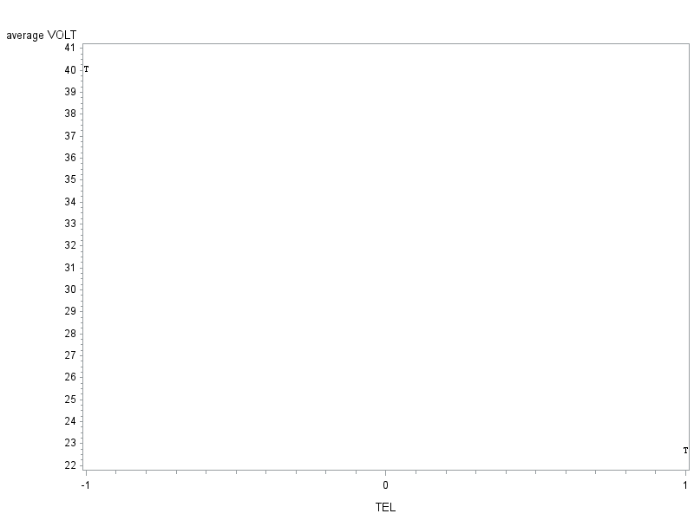
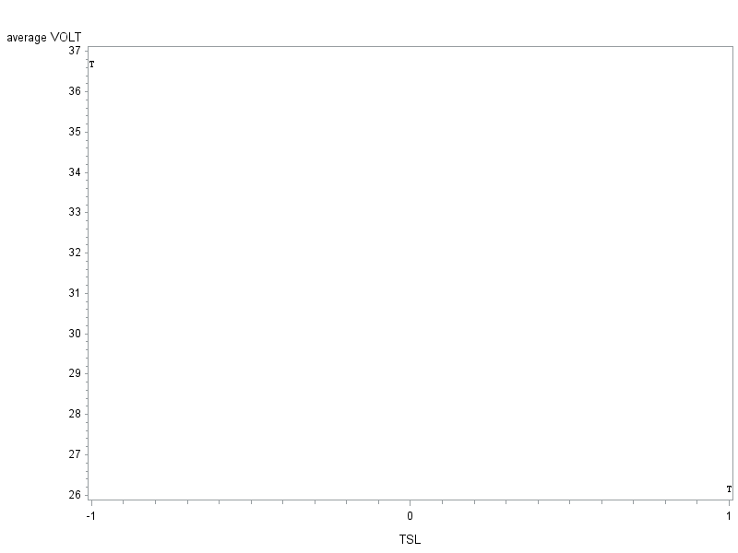
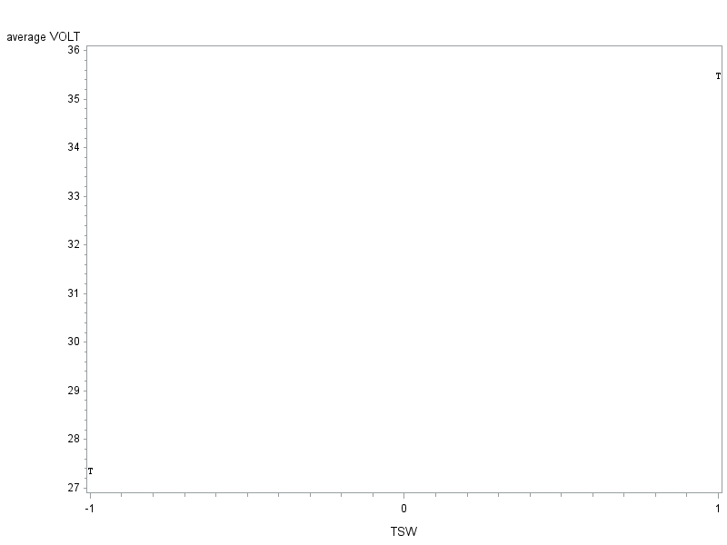
Interpret Results
Main Effects Plot
For Low voltage:
TEL: +1
TSL: +1
TSW: -1

Slide 15
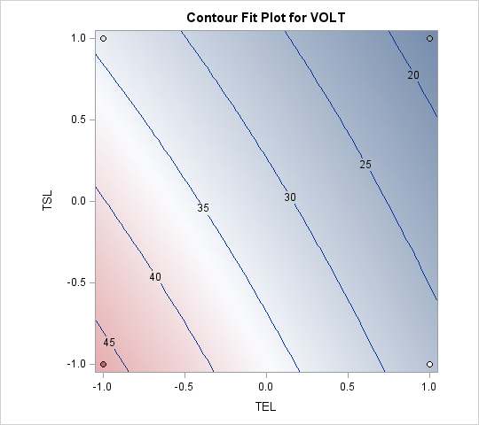
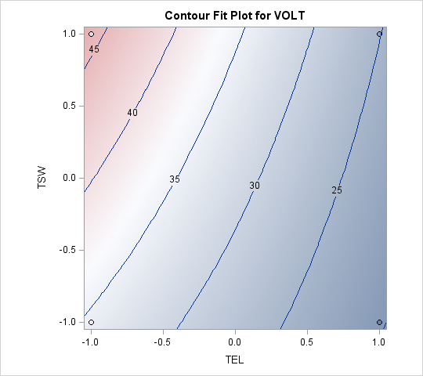
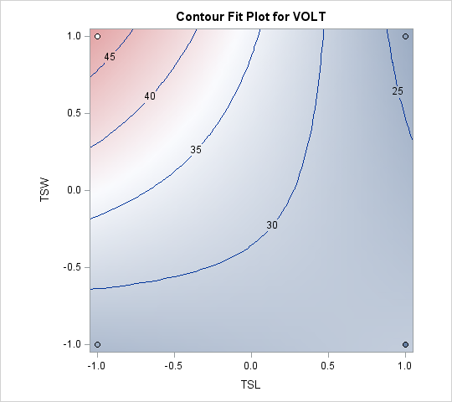
Contour Plot
The direction of movement for optimal response is shown in the figure.
Recommendation : For low response VOLT
TEL : +1
TSL : +1
TSW : -1

Slide 16
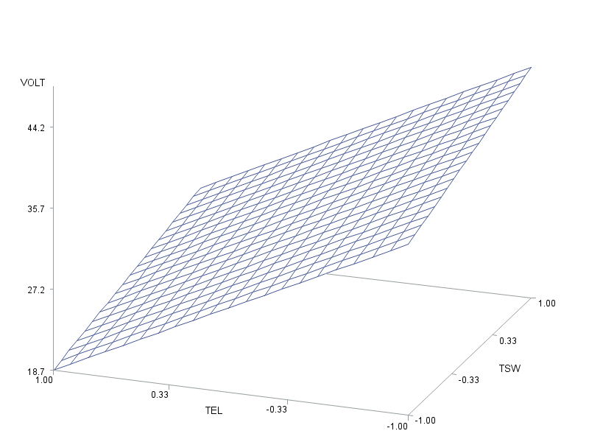
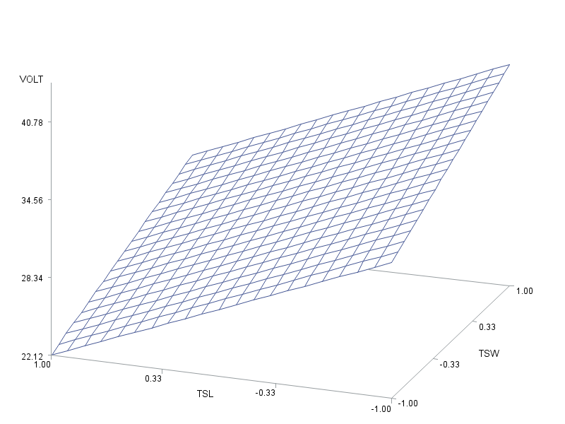
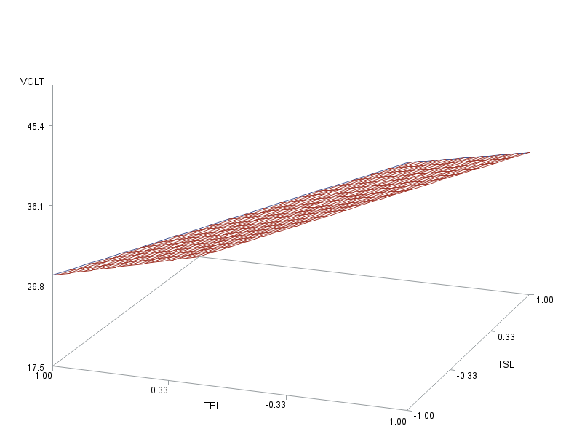
TEL : +1 TSL : +1 TSW : -1 Response Surface Plots

Slide 17
Predicted Values
Output Statistics
Obs | TEL | TSL | TSW | Dependent Variable | Predicted Value | Std Error Mean Predict | 95% CL Mean |  | 95% CL Predict |  | Residual
1 | 1 | 1 | 1 | 18.5 | 21.5667 | 3.4523 | 13.6057 | 29.5277 | 5.6447 | 37.4887 | -3.0667
2 | -1 | -1 | 1 | 48.0 | 49.4667 | 3.4523 | 41.5057 | 57.4277 | 33.5447 | 65.3887 | -1.4667
3 | -1 | 1 | -1 | 32.0 | 30.8000 | 3.4523 | 22.8390 | 38.7610 | 14.8780 | 46.7220 | 1.2000
4 | 1 | -1 | 1 | 36.0 | 32.1000 | 3.4523 | 24.1390 | 40.0610 | 16.1780 | 48.0220 | 3.9000
5 | -1 | -1 | -1 | 32.8 | 41.3333 | 3.4523 | 33.3723 | 49.2943 | 25.4113 | 57.2553 | -8.5333
6 | -1 | 1 | -1 | 38.4 | 30.8000 | 3.4523 | 22.8390 | 38.7610 | 14.8780 | 46.7220 | 7.6000
7 | -1 | -1 | 1 | 57.8 | 49.4667 | 3.4523 | 41.5057 | 57.4277 | 33.5447 | 65.3887 | 8.3333
8 | 1 | -1 | -1 | 22.5 | 23.9667 | 3.4523 | 16.0057 | 31.9277 | 8.0447 | 39.8887 | -1.4667
9 | 1 | -1 | -1 | 23.2 | 23.9667 | 3.4523 | 16.0057 | 31.9277 | 8.0447 | 39.8887 | -0.7667
10 | 1 | 1 | -1 | 15.4 | 13.4333 | 3.4523 | 5.4723 | 21.3943 | -2.4887 | 29.3553 | 1.9667
11 | -1 | 1 | 1 | 31.8 | 38.9333 | 3.4523 | 30.9723 | 46.8943 | 23.0113 | 54.8553 | -7.1333
12 | 1 | 1 | 1 | 21.0 | 21.5667 | 3.4523 | 13.6057 | 29.5277 | 5.6447 | 37.4887 | -0.5667

Slide 18
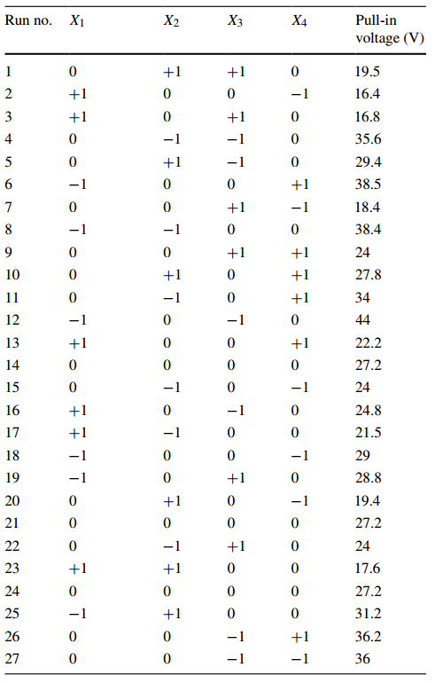
Phase 2: Response Surface Methodology (Box-Benken Design)
A spherical Design: all points are of same distance from the center
Based on the construction of Balanced Incomplete Block Design (BIBD)
Rotatable or nearly Rotatable
Very Efficient: requires less runs
27 runs are presented in the table

Slide 19
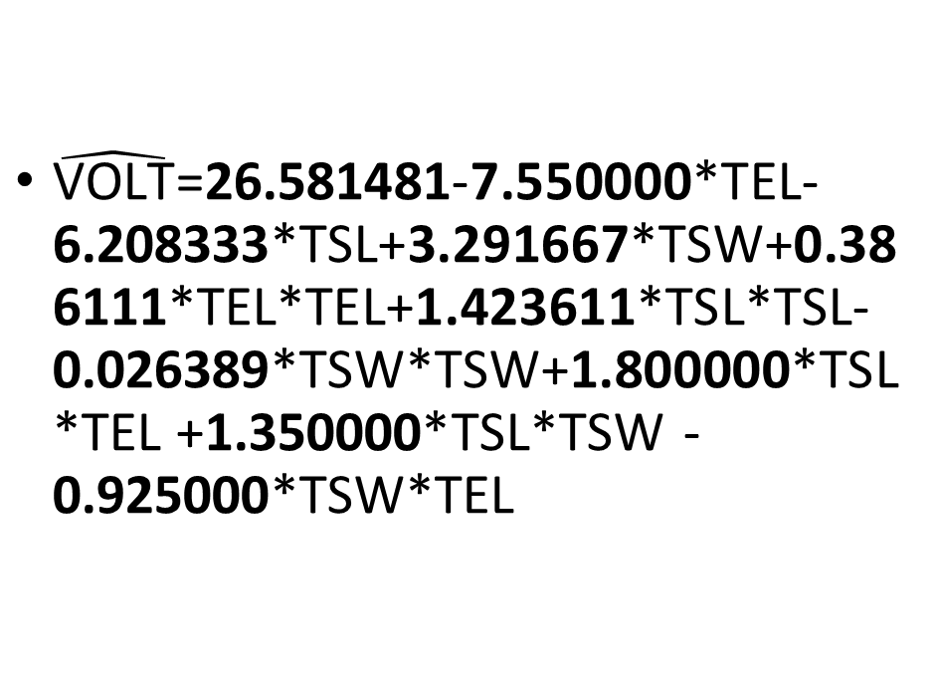
Second Order Model
$\hat{\text{VOLT}}$=26.581481-7.550000*TEL-6.208333*TSL+3.291667*TSW+0.386111*TEL*TEL+1.423611*TSL*TSL-0.026389*TSW*TSW+1.800000*TSL*TEL +1.350000*TSL*TSW -0.925000*TSW*TEL

Slide 20
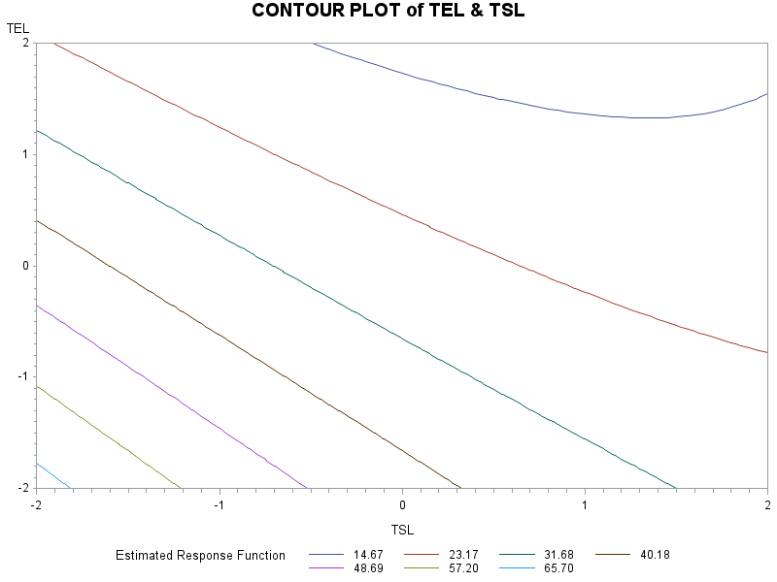
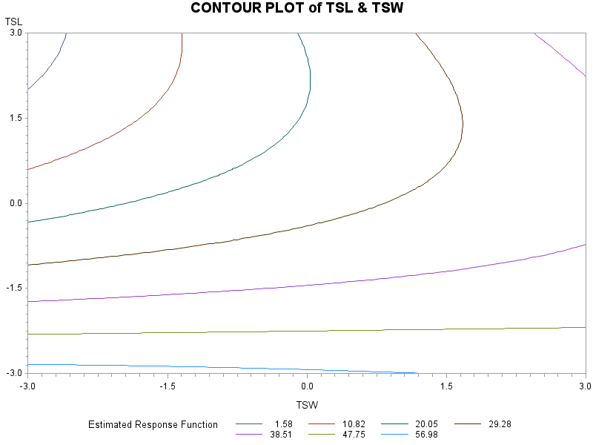
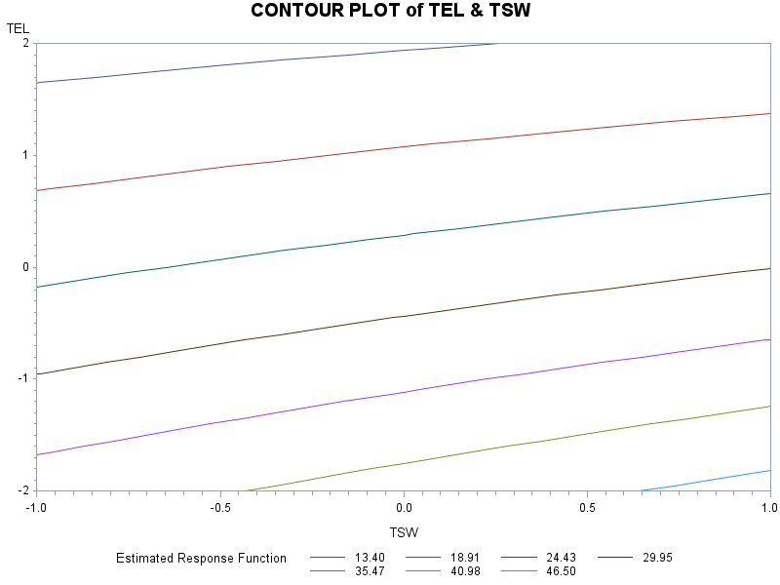
Response Surface Method: 1. Contour Plot

Slide 21
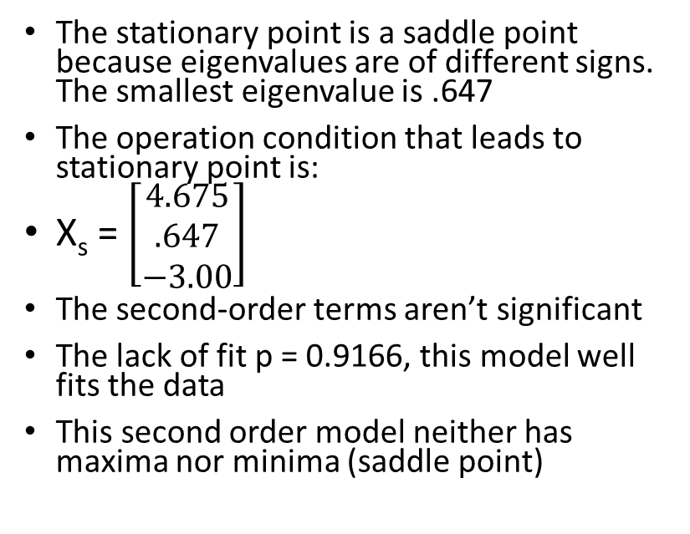
Response Surface Summary
The stationary point is a saddle point because eigenvalues are of different signs. The smallest eigenvalue is .647
The operation condition that leads to stationary point is:
X_{s} = $\left[\begin{matrix}4.675 \\ .647 \\ −3.00\end{matrix}\right]$
The second-order terms aren’t significant
The lack of fit p = 0.9166, this model well fits the data
This second order model neither has maxima nor minima (saddle point)

Slide 22
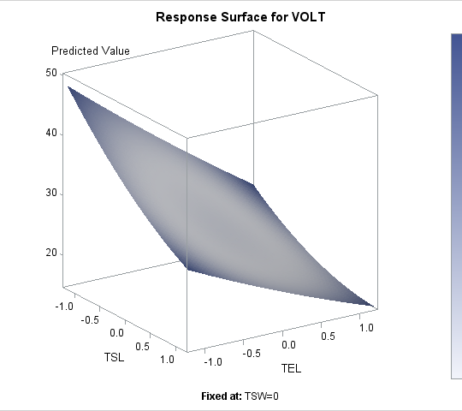
Response Surface Plot
TSL vs. TEL
The curvature Structure is not obvious

Slide 23
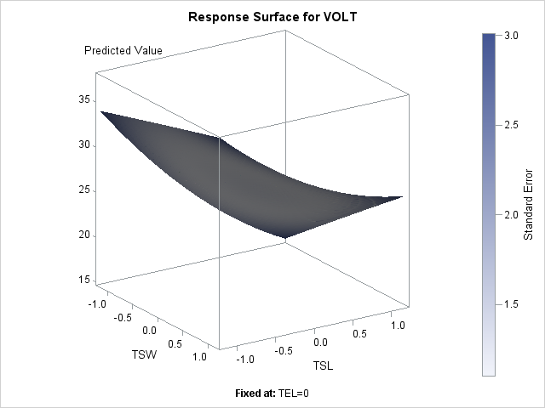
Response Surface Plot
TSL vs. TSW
The curvature Structure is not obvious

Slide 24
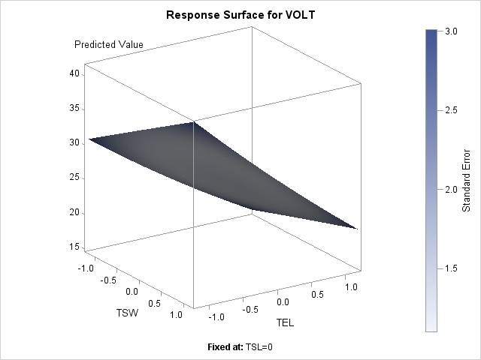
Response Surface Plot
TSW vs. TEL
The curvature Structure is not obvious
Note:
Non of the curvature are significant
It is not helping for finding optimal solution
we stick to the phase-I model

Slide 25
Summary of Two Phases
Phase-I
(P-B Design)
Resulted in 3 factor design
R-Sq = 0.834
Phase-II
(Box-Benken Design)
Non of the two-factor interactions are significant
Found Stationary point as a saddle point
R-Sq = 0.909
Best predicted response 13.433

Slide 26
Model Comparison My Design is Better ☺
Paper’s Model
Resulted in 3 factor Design
R-Sq = 0.834
Gaurav’s Model
Resulted in 4 factor Design
R-Sq = 0.997
Best predicted response is 13.433 V
Best predicted response 14.29 V

Slide 27
Scope of Improvement
Adding center point after initial screening to test whether second-order model is significant or not before moving directly to Box-Benken Design

Slide 28
Any Questions ? ☺

